Slide 1
Neha Goud Baddam
Examining COVID-19 Forecasting using Spatio-Temporal Graph Neural Networks
Amol Kapoor*, Xue Ben*, Luyang Liu, Bryan Perozzi, Matt Barnes, Martin Blais, Shawn O’Banion [ajkapoor,sherryben,luyangliu,hubris,mattbarnes,blais,obanion]@google.com Google Research
MLG Workshop

Slide 2
Introduction
COVID-19
COVID-19 spread globally in early 2020, leading to millions of infections and significant economic impacts.
Existing Approaches
Mechanistic Models: Compartmental and agent-based models encode disease dynamics at population or individual levels.
Accurate forecasting helps policymakers allocate healthcare resources, control outbreaks, and protect public safety.
Time-Series Models: Techniques like curve-fitting, autoregression, and deep learning rely on historical data from each time point independently.
Example: Imagine you know that one sick person will spread the illness to two others. You could use this rule to predict how many people might get sick over time.
Example: It’s like noticing that cases increased every week for a month and then using this pattern to guess the number of cases for the next week.

Slide 3
Introduction
Limitations
Most models assume forecasts depend on data from a single location or closed system.
Research Motivation
Real-time data on inter-regional interactions can improve forecast accuracy.
Study Goal
However, a region’s COVID-19 cases are also affected by human mobility and interactions between regions.
Mobile GPS data provides new, detailed insights into human mobility patterns, supporting this research.
Forecast county-level COVID-19 cases in the U.S. using a GNN that captures both spatial and temporal dynamics.
Example: If you’re predicting cases in one city without considering that people from nearby cities are visiting, your prediction might miss important details.

Slide 4
BACKGROUND

Slide 5
Mobility Data in Graphs
Importance of Mobility Data
Recent advances allow detailed tracking of human mobility, crucial for accurately modeling disease spread.
Previous Research
Studies have shown that international flights contributed significantly to the early global spread of COVID-19.
This data also aids in assessing the effectiveness of non-pharmaceutical interventions (NPIs) for COVID-19, such as social distancing and travel restrictions.
COVID-19 analysis using the SafeGraph dataset highlighted how NPIs like social distancing impacted disease dynamics.

Slide 6
Spatio-Temporal GNNs
GNN Overview
Graphs naturally represent complex data structures across many fields, including social, biological, and financial domains.
Spatio-Temporal Graphs
These graphs model connections between nodes over time and space, making them ideal for dynamic data modeling.
GNNs have shown superior performance in tasks such as node classification, link prediction, community detection, and recommendations.
They have been successfully applied in areas like traffic prediction and disease forecasting (e.g., influenza).

Slide 7
METHOD

Slide 8

Graph Neural Networks
Message Propagation
Each node gathers information from its neighboring nodes and combines these signals into a message.
Node Updating
Each node updates its own representation using the aggregated messages from its neighbors.
G (l) is the update function at layer 𝑙. It takes the current representation of node 𝑖 and the aggregated message 𝑚𝑖(𝑙+1) to produce the new representation ℎ𝑖(𝑙+1)
F (l) is the message function at layer 𝑙, which determines how information from node 𝑗 is transformed and passed to node 𝑖.

Slide 9
Modeling the COVID-19 Graph
Graph-Based Structure for Mobility Data
COVID-19 transmission data is structured as a spatio-temporal graph rather than a simple time series.
Spatial and Temporal Dependencies
Spatial Edges: Represent direct connections between locations based on human movement.
Nodes in this graph represent regions (e.g., counties), with edges indicating human mobility between regions, weighted by normalized mobility flow.
Temporal Edges: Represent connections across time, linking nodes to their own past states (up to a week prior).
Example: Think of a graph where each node is a city. The edges change based on people moving from one city to another at different times of the day. This graph captures both spatial (location) and temporal (time) data.

Slide 10
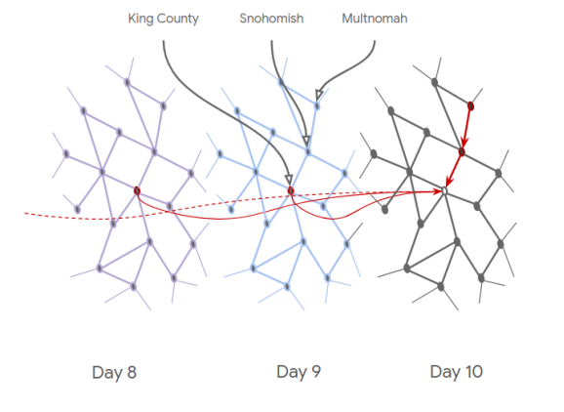
Modeling the COVID-19 Graph
Graph Setup
The graph comprises 100 stacked layers representing each day from February 22, 2020, to May 31, 2020.
Each county (node) in a daily layer connects to its previous seven days, capturing a week’s temporal data for predictive modeling.
Figure 1: Shows a "slice" of the COVID-19 graph across three days, with spatial connections between counties and temporal connections (highlighted in red) between days.

Slide 11
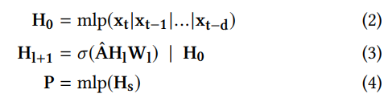
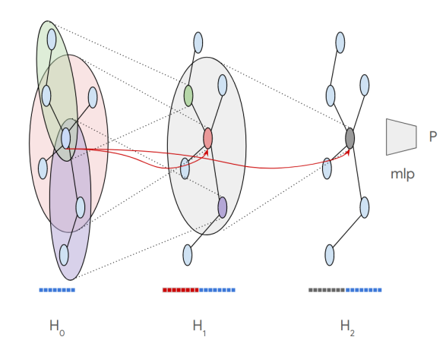
Skip-Connections Model
Mathematical Formulation
Initial Embedding (H₀): Generated by a multi-layer perceptron (MLP) over temporal features for up to d past days.
Skip Connections
By including skip connections, information from one layer is directly passed to the next layer without modification. This helps retain the original data for each node, preventing it from getting “diluted” or lost as it passes through multiple layers.
Layer Update (Hl+1): Uses a normalized adjacency matrix (Â), a weight matrix (W), and a non-linearity (ReLU) for each layer, along with concatenation (|) to retain initial embeddings.
Final Prediction (P): Produced by an MLP over spatial hops, providing the forecast for COVID-19 cases based on learned spatio-temporal embeddings.
Figure 2: Illustrates the skip-connection model, where each layer retains information by connecting back to earlier layers.

Slide 12
EXPERIMENTS

Slide 13
DATA
Datasets
New York Times (NYT) COVID-19 Dataset: Provides case and death counts for daily reporting at the state and county level in the U.S.
Google COVID-19 Aggregated Mobility Research Dataset: Tracks weekly movement between regions, capturing mobility before and during the pandemic.
Google Community Mobility Reports: Summarizes mobility trends across different place categories (e.g., grocery stores, parks, transit stations) and at the county level.

Slide 14
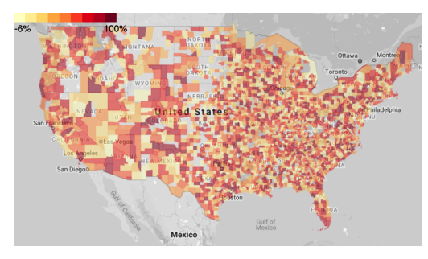
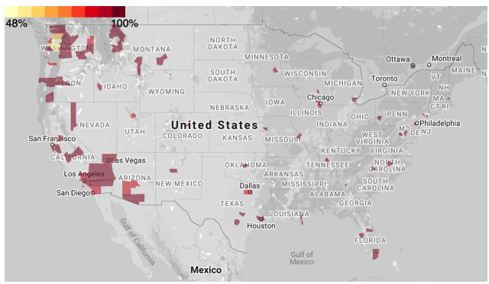
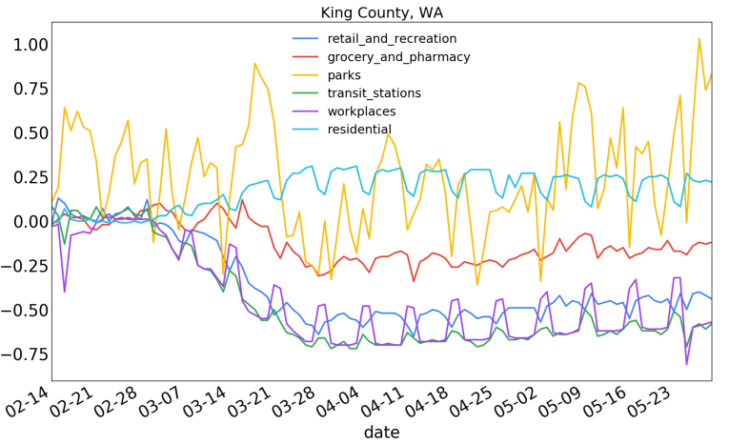
DATA
Common Node Features: Each node (representing a location) contains the following features:
Data Details
State, county, and day
COVID-19 cases and death counts (normalized vectors over d days)
Aggregated Mobility Research Dataset:
Inter-county flows and Intra-county flows
Community Mobility Reports:
The Community Mobility Reports show changes in how people visit different categories of places. Each category has a baseline (a normal value) based on data collected in early 2020. Deviations from this baseline help researchers understand behavioral changes during the pandemic:
Figure 3, showing how movement dropped in April compared to January as people stayed in place more.
Figure 4, gives a more specific example from King County, Washington, showing a drop in air travel from distant counties, with a smaller drop from nearby counties.

Slide 15
Limitations of Data Sources
Limitations
Google mobility data: Only includes data from smartphone users who opted in to Google’s Location History feature. This means it doesn’t represent everyone, as many people don’t use this feature.
Differential privacy: Google applies privacy algorithms to make sure individual users aren’t identifiable. While this is important for privacy, it may also obscure some details in the data.
Missing factors: The data doesn’t cover certain factors like mask-wearing, weather changes, or increased awareness of the virus. These factors can still reduce transmission risk even if people’s mobility remains the same.

Slide 16
Hyperparameters, Architectures, and Splits
GNN Experimental Settings
A 7-day time horizon (one week) is used for the experiments.
GNN Model Details
Optimizer: Adam with a learning rate of 1e-5.
Spatial data includes 2 hops of neighbors, considering the 32 neighbors with the highest edge weight for each hop.
Model Architecture:
Four hidden layers: Two-hop spatial model with a single-layer MLP on either side
Dropout rate of 0.5 for regularization.
Training Details:
Trained for 1 million steps.
An initial embedding layer (to prepare the input data).
Two spatial aggregation layers (to capture information from neighboring nodes).
A final prediction layer (for output).
MSLE (Mean Squared Logarithmic Error) regression loss.

Slide 17
Hyperparameters, Architectures, and Splits
Model Objective
Models are trained to predict the change in the number of cases on day t+1, using previous data.
Data Splits
Training data from Days 59–120 (roughly March–April 2020).
Testing data from Days 120–150 (roughly May 2020).

Slide 18
BASELINES
No Mob Baselines
These baselines do not utilize any mobility information.
Previous Day
The two baselines check different assumptions: either cases will continue to change like yesterday or stay the same.
Previous Delta: Predicts that the delta (change) in cases will be the same as the previous day's delta.
Previous Cases: Predicts that the number of cases will remain the same as the previous day.
ARIMA
ARIMA uses only daily new case counts to make predictions, ignoring other features like mobility or region information.
LSTM
A stack of two LSTM layers (32 and 16 units) followed by a dense layer.
By using LSTMs, the model can learn trends over time, like the steady rise in cases during an outbreak.
Seq2Seq
Encoder-decoder architecture using GRU layers (32 and 16 units).
The Seq2Seq model summarizes patterns into a compressed form with the encoder. For instance, if cases rise every three days, the model learns this pattern and generates a summary.
The decoder “unpacks” this compressed information to predict future cases, reconstructing the sequence with predicted values for each future day.

Slide 19
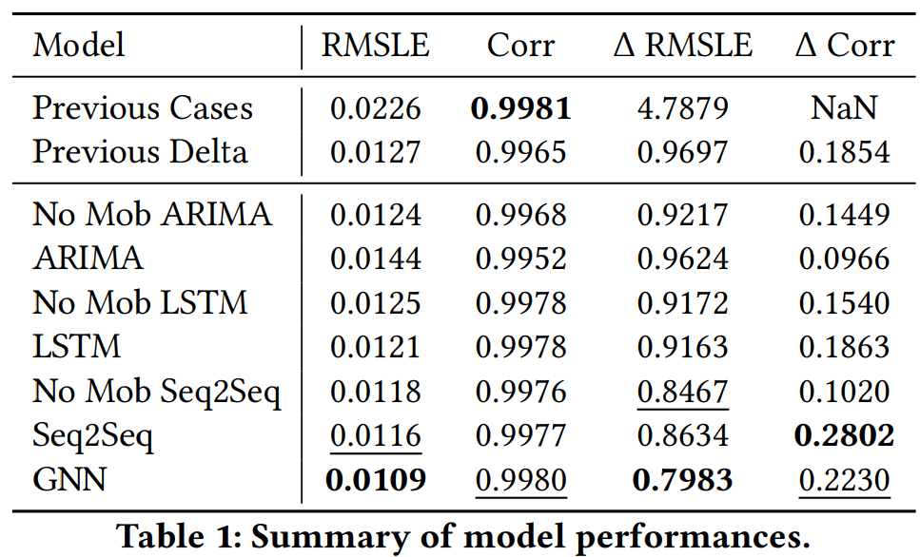
RESULTS
Case Prediction Performance
Table 1 compares the forecasting performance of the spatio-temporal GNN against various baseline models using two metrics:
RMSLE (Root Mean Squared Logarithmic Error)
Pearson Correlation (Corr)

Slide 20
LIMITATION & FUTURE WORK
Key Highlights:
Unlike previous mechanistic or autoregressive models, GNN framework does not rely on fixed assumptions about disease dynamics.
Future Directions:
Incorporating new features for better prediction accuracy.
Expanding the time horizon for long-term predictions.
Applying epidemiological mobility data in other regions worldwide to test the model’s robustness.
Instead, it can learn from diverse data sources, including inter-region interactions and region-level features, making it adaptable and powerful for forecasting.
Limitations:
The model focuses on a limited number of counties (top 20 by population). Scaling this framework to include all counties or to operate on a global scale could present computational challenges.

Slide 21

Questions?

Slide 22
Thank You!

